Slide 1



UNIT 4
LESSON 15
Healthy and happy
Part 3

Slide 2
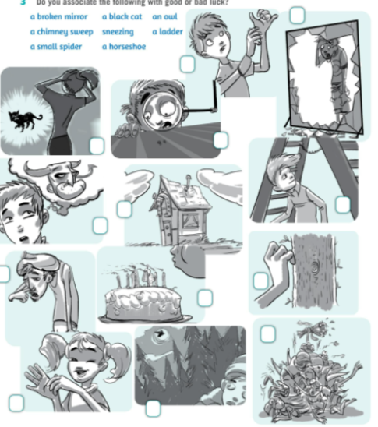
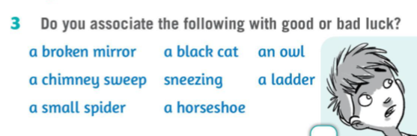
SUPERSTITION
Describe the pictures: What is going on? What has just happened? You can make a two-line dialogue following the given model:
Opišite slike. Osmislite kratak razgovor prema primjerima:
Belief that is not based on human reason or scientific knowledge, but is connected with old ideas about magic, etc.
Are you superstitious?
A: He’s rubbing his left hand.
B: Bad luck. If your left hand itches, you will soon pay out money.
Open your Workbook, page 148.
Otvorite radnu bilježnicu na stranici 148.
A: He’s got a terrible cold. He’s about to sneeze.
B: Bad luck. There’s no one around. If you sneeze and nobody says ‘Bless you’, the devil will enter your body.
Povezujete li sljedeće izraze s dobrom ili lošom srećom?

Slide 3
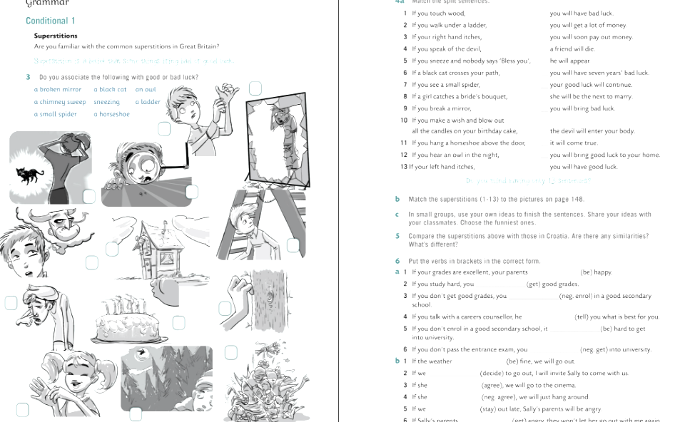
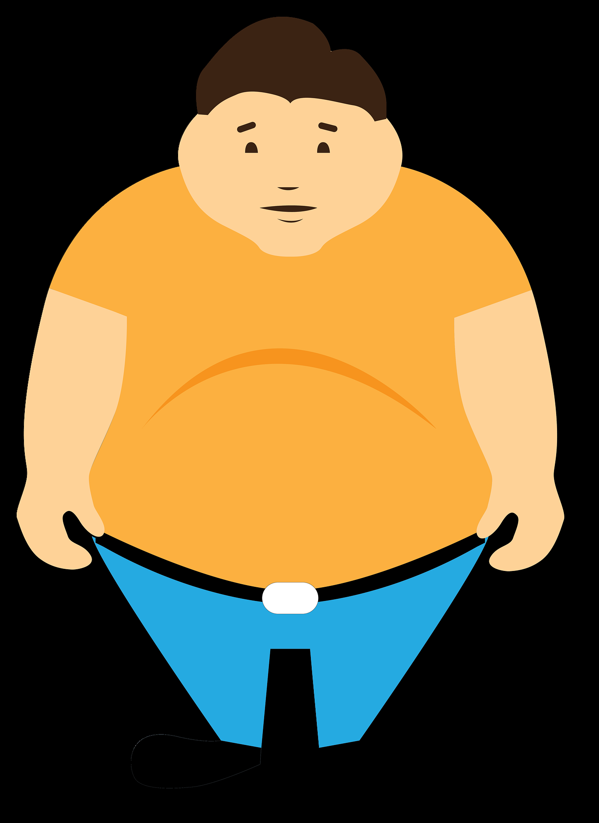
It’s 6 o’clock. Ewan is awake before his mum comes to wake him up. He has had bad dreams again. He has breakfast and then leaves for school. While waiting for the bus he can’t stop worrying. He feels sick. The bus comes, he gets on and looks around. Thank Goodness. ‘Touch wood.’ Why?

Slide 4
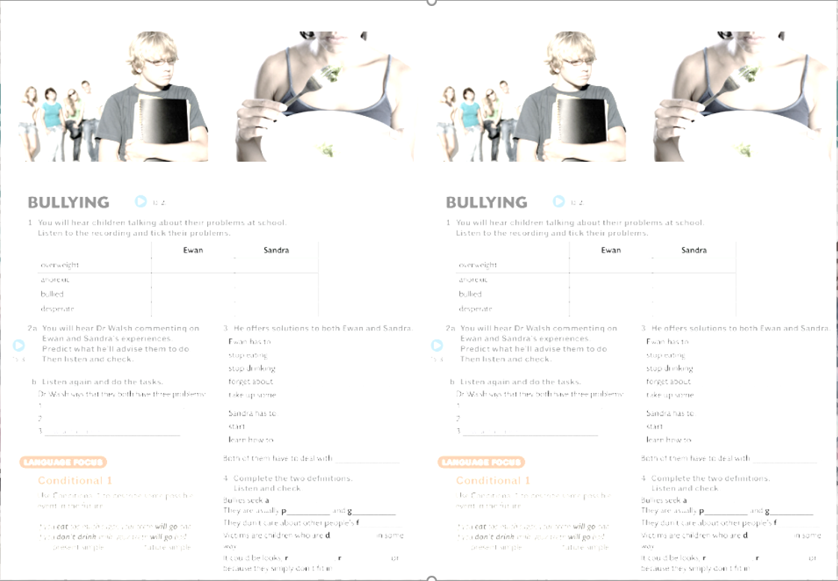
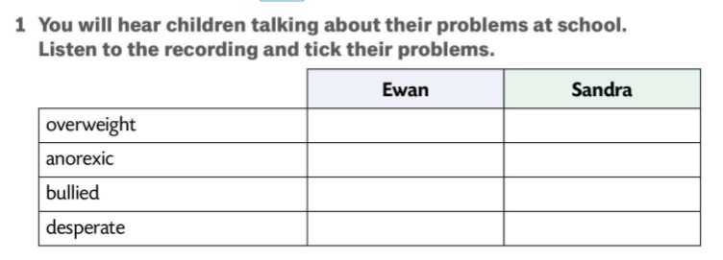


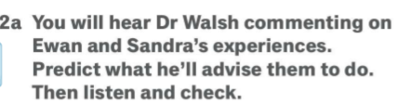
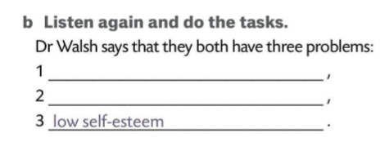
Open your Class Book, page 128.
Otvorite udžbenik na stranici 128.
Čut ćete djecu koja razgovaraju o problemima u školi. Poslušajte i označite probleme.
Poslušajte ponovno i riješite zadatak.
food problem
bullying
Poslušat ćete što doktor Walsh kaže o Ewanovim i Sandrinim iskustvima. Predvidite što će im savjetovati. Zatim poslušajte i provjerite.

Slide 5
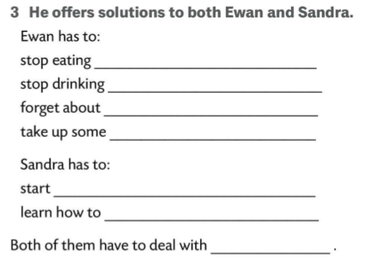
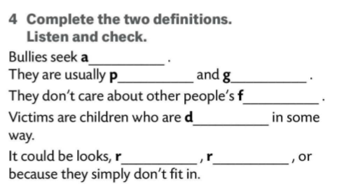
Doktor Walsh nudi rješenja Ewanu i Sandri.
Have a discussion about bullying. How can school, peers, and parents help? Do you know or have heard of any cases of bullying?
junk food.
fizzy drinks.
snacks.
or any kind of physical activity.
eating normally.
Dopunite. Zatim poslušajte i provjerite.
love herself.
deal with bullying.
ttention
opular
ood-looking
eelings
ifferent
ace
eligion

Slide 6
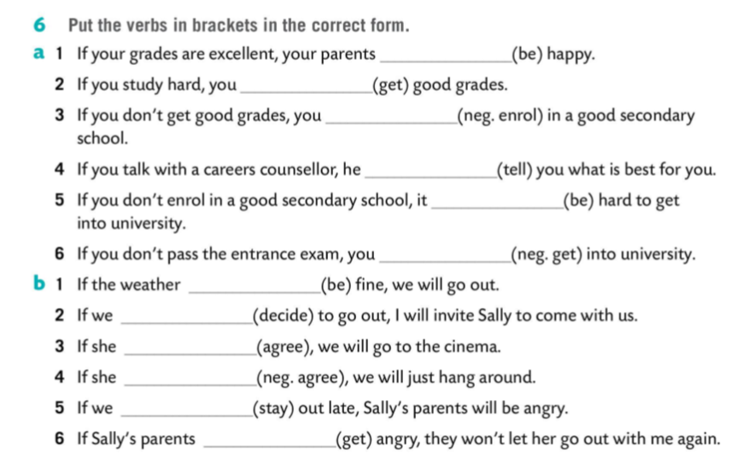
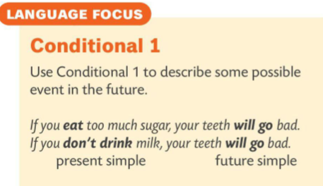

Open your Workbook, page 149.
Otvorite radnu bilježnicu na stranici 149.
Pravilno oblikujte riječi u zagradama.
will be
will get
won’t enroll
will tell
will be
won’t get
Pomoću slike s poveznicom pristupite igri za ponavljanje.
is
decide
agrees
doesn’t agree
stay
get

